Slide 1

City of Kerrville, Texas
Tax Increment Reinvestment Zone #1
Project and Financing Plan (PFP)
OCTOBER 2018

Slide 2
OVERVIEW
Prior Briefings/Activities
City of Kerrville, Tax Increment Reinvestment Zone #1
Project and Financing Plan (PFP)
Statutory Funding Categories
Amendments to Project and Financing Plan
Next Steps
Moving Forward
PURPOSE

Slide 3
PRIOR BRIEFINGS/ACTIVITIES
TIF ACTIVITIES
March 16, 2018
Downtown Stakeholders Meeting
June 12, 2018
City Council Briefing
August 21, 2018
City Council TIRZ WORKSHOP
September 11, 2018
Public Hearing and First Reading of Ordinance
September 25, 2018
2nd Reading of Ordinance

Slide 4
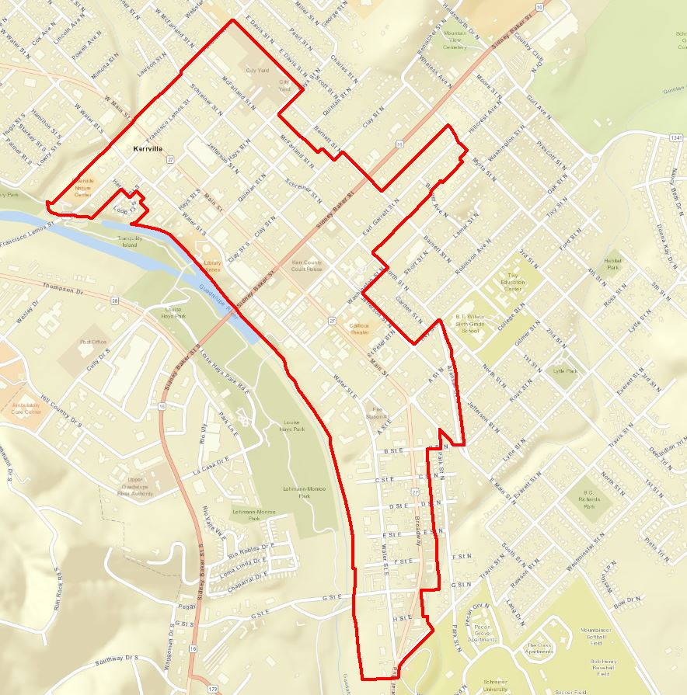
City of Kerrville, Tax Increment Reinvestment Zone #1
TIRZ #1
Created on September 25, 2018
The goal of TIRZ #1 is to fund needed public infrastructure and to encourage private development that will yield additional tax revenue to all local taxing jurisdictions.
Base Year 2018
30 year term
City participation 100%

Slide 5
TIRZ #1 – PROJECT AND FINANCING PLAN (PFP)
PFP
After TIF Creation Ordinance the Project and Financing Plan is recommended by the TIRZ Board to the City Council for approval
City Council approval of PFP by separate ordinance
Scheduled considerations:
  10/9: TIRZ Board Meeting – PFP
  10/9: City Council Meeting – 1ST Reading PFP Ordinance
  10/23: City Council Meeting – 2nd Reading PFP Ordinance

Slide 6
TIRZ #1 – PROJECT AND FINANCING PLAN (PFP)
PFP
ADAPTABLE ROADMAP
The Project and Financing Plan has been prepared to afford the authority to fund projects per the requirements of Chapter 311 of the Texas Tax Code.
The Project Plan provides funding categories to meet demands as specific projects evolve.
Each project will have specific needs that will need to be fully evaluated and approved by the TIRZ Board and City Council.
No PFP can predict the future, but the proposed PFP provides flexibility through statutory categories to meet future demands.
Plans without flexibility have had limited success given inevitable changes in the marketplace.

Slide 7
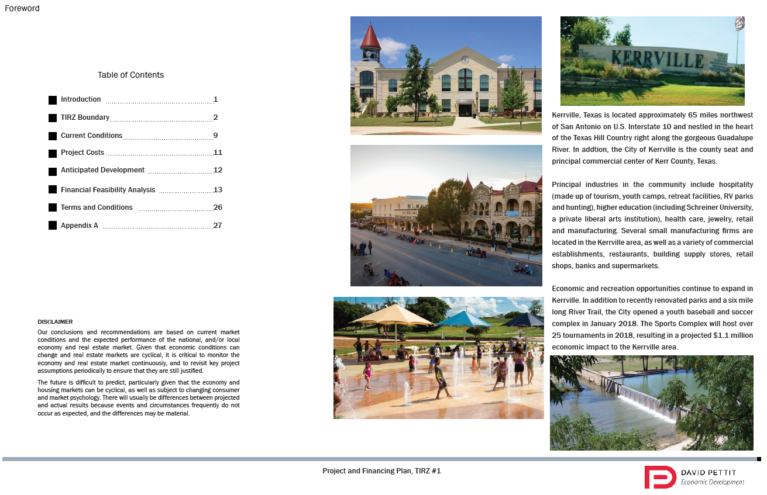
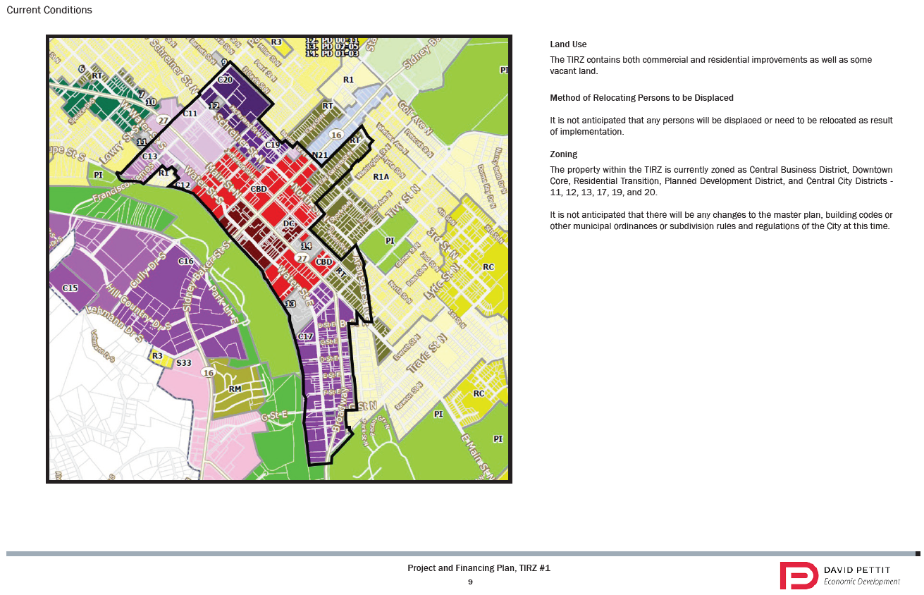
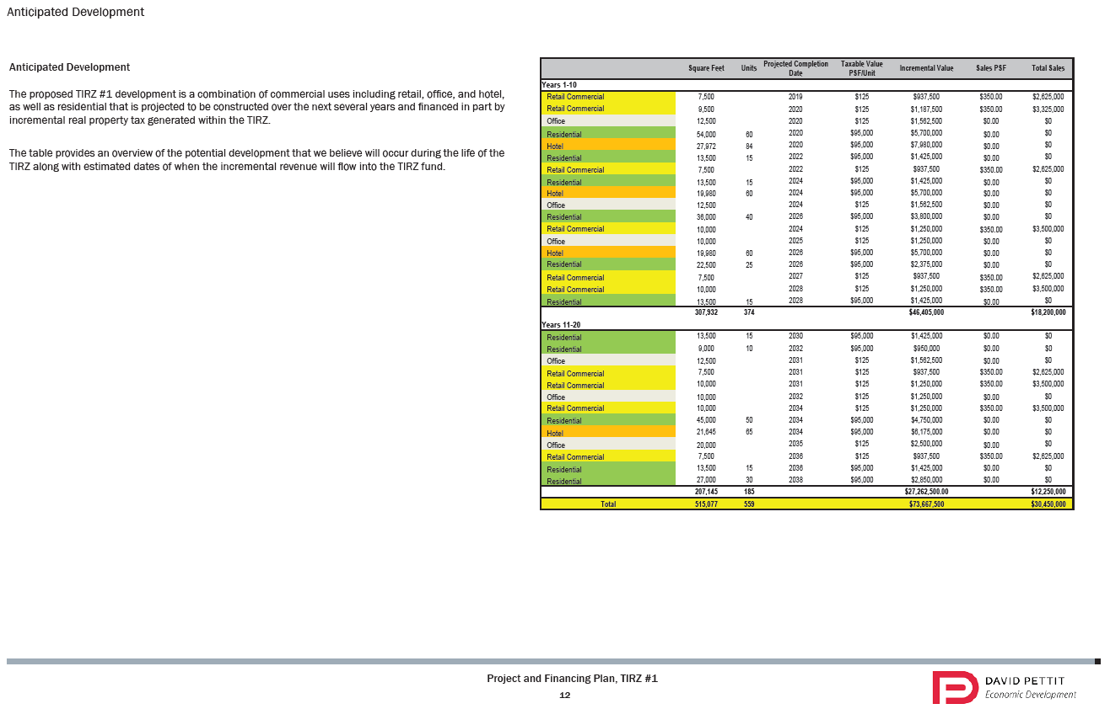
Amendments to Project and Financing Plan
Per Chapter 311.011(e) of the Texas Tax Code:
  At any time after the zone is adopted, the board of directors may adopt an amendment to the project plan.
  The amendment takes effect on approval of the change by ordinance by the city or order by the county that created the zone and in certain cases may require an additional public hearing.
PFP

Slide 8
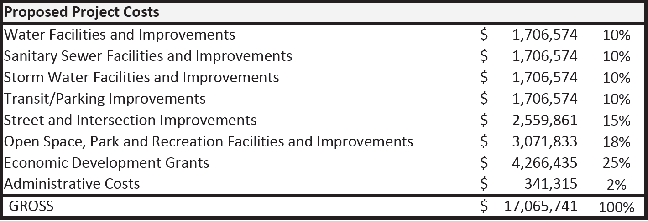
TIRZ #1 – PROJECT AND FINANCING PLAN (PFP)
PFP
Anticipate commercial development consisting of retail, office, hotel, as well as residential development.
The costs illustrated in the table above are estimates and are authorized categories to fund potential projects.
Savings from one line item may be applied to cost increase in another line item.

Slide 9
NEXT STEPS
TIRZ BOARD
TIRZ Board will meet as needed to evaluate funding requests as they come forward.
Sec. 311.016. ANNUAL REPORT BY MUNICIPALITY
  On the 150th day following the end of the fiscal year of the municipality a report on the status of the zone must be prepared.
  The report must include:
    amount and source of revenue in the tax increment fund;
    amount and purpose of expenditures from the fund;
    tax increment base and current captured appraised value retained by the zone; and
    captured appraised value shared by the municipality or county and other taxing units, the total amount of tax increments received; and
    municipality shall send a copy of a report made under this section to the comptroller.
NEXT STEPS

Slide 10
MOVING FORWARD
MOVING FORWARD
  10/9: City Council Meeting – 1ST Reading PFP Ordinance
  10/23: City Council Meeting – 2nd Reading PFP Ordinance
  TBD: TIRZ Board meetings
  At a minimum annually (Annual Report and Budget);
  as needed to consider funding requests; and
  Board recommends projects for approval to the City Council.

